Slide 1




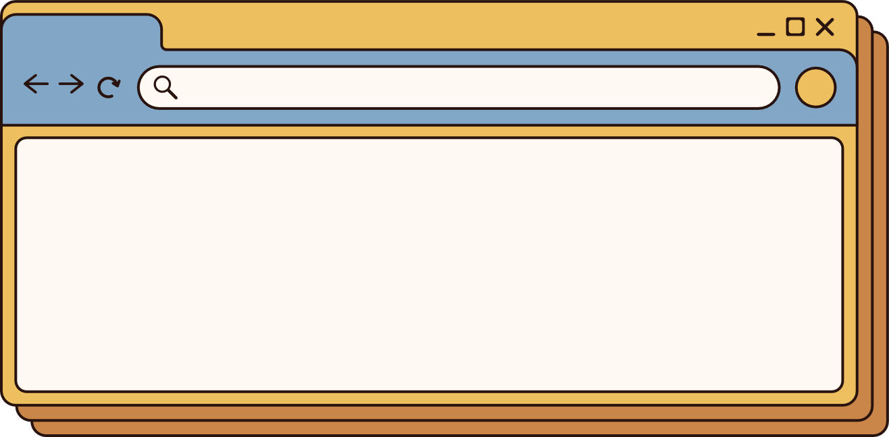

AI Virtual Teacher
Presented by Pritam & Smrutiprava

Slide 2






Introduction
Introducing AVT (AI Virtual Teacher), your personalized AI virtual teacher revolutionizing education. With AVT, learning becomes interactive, tailored, and accessible 24/7. Our platform employs cutting-edge AI to adapt to individual learning styles, delivering engaging content, immersive simulations, and real-time feedback. Whether it's academic subjects or personal development, AVT empowers users to learn at their own pace, anytime, anywhere.

Slide 3

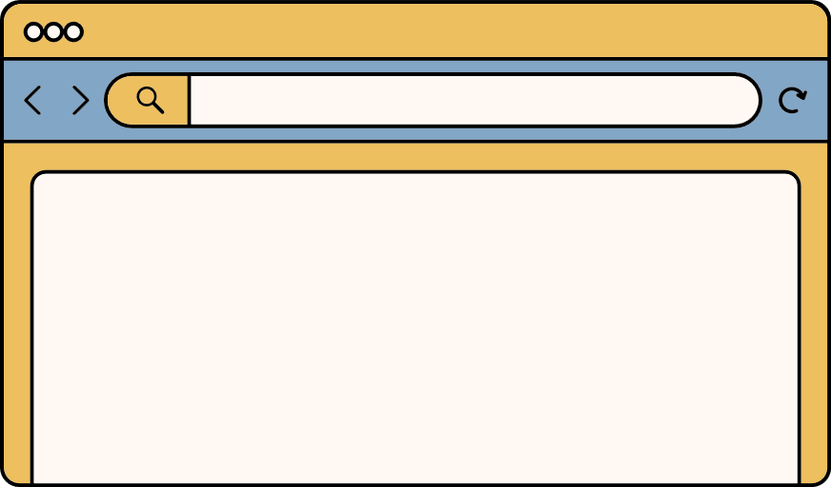



Problem Statement
Traditional classroom settings often struggle to cater to the diverse learning needs of students. Additionally, with the rise of remote learning, students face challenges in accessing personalized support and guidance from teachers. There's a need for an innovative solution that bridges this gap and provides tailored educational experiences to students anytime, anywhere.

Slide 4




Project Ideas
Personalized Learning
24/7 Availability
Questions after session
Artificial Intelligence
no fear to ask doubts
accessible anytime

Slide 5
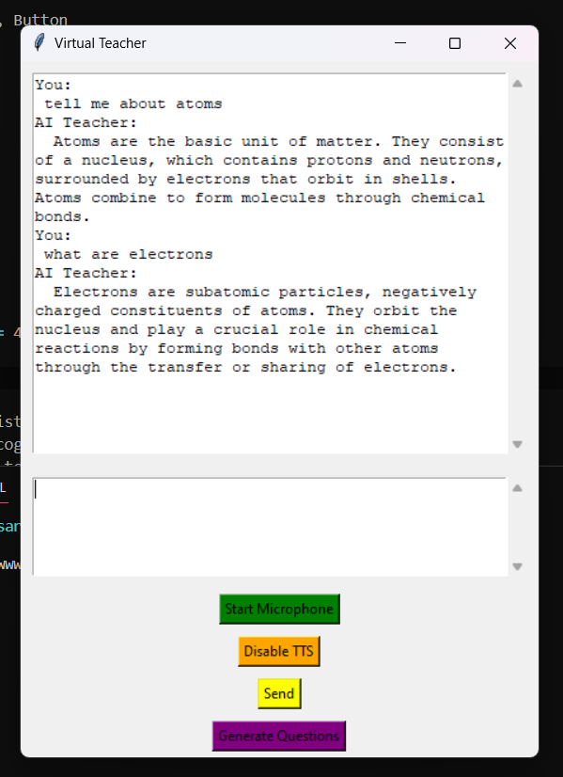
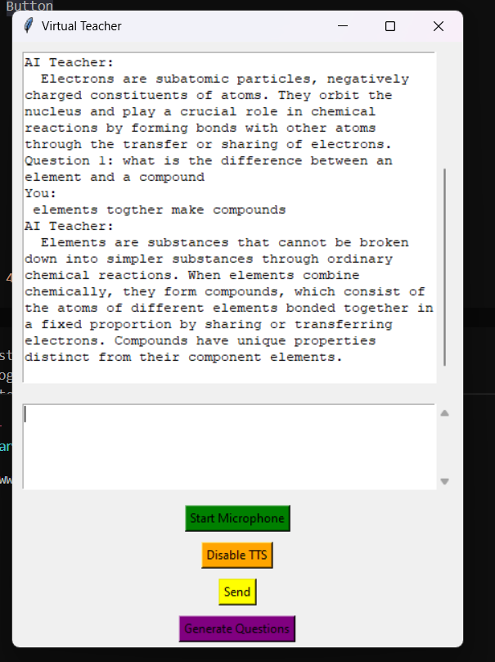

Slide 6


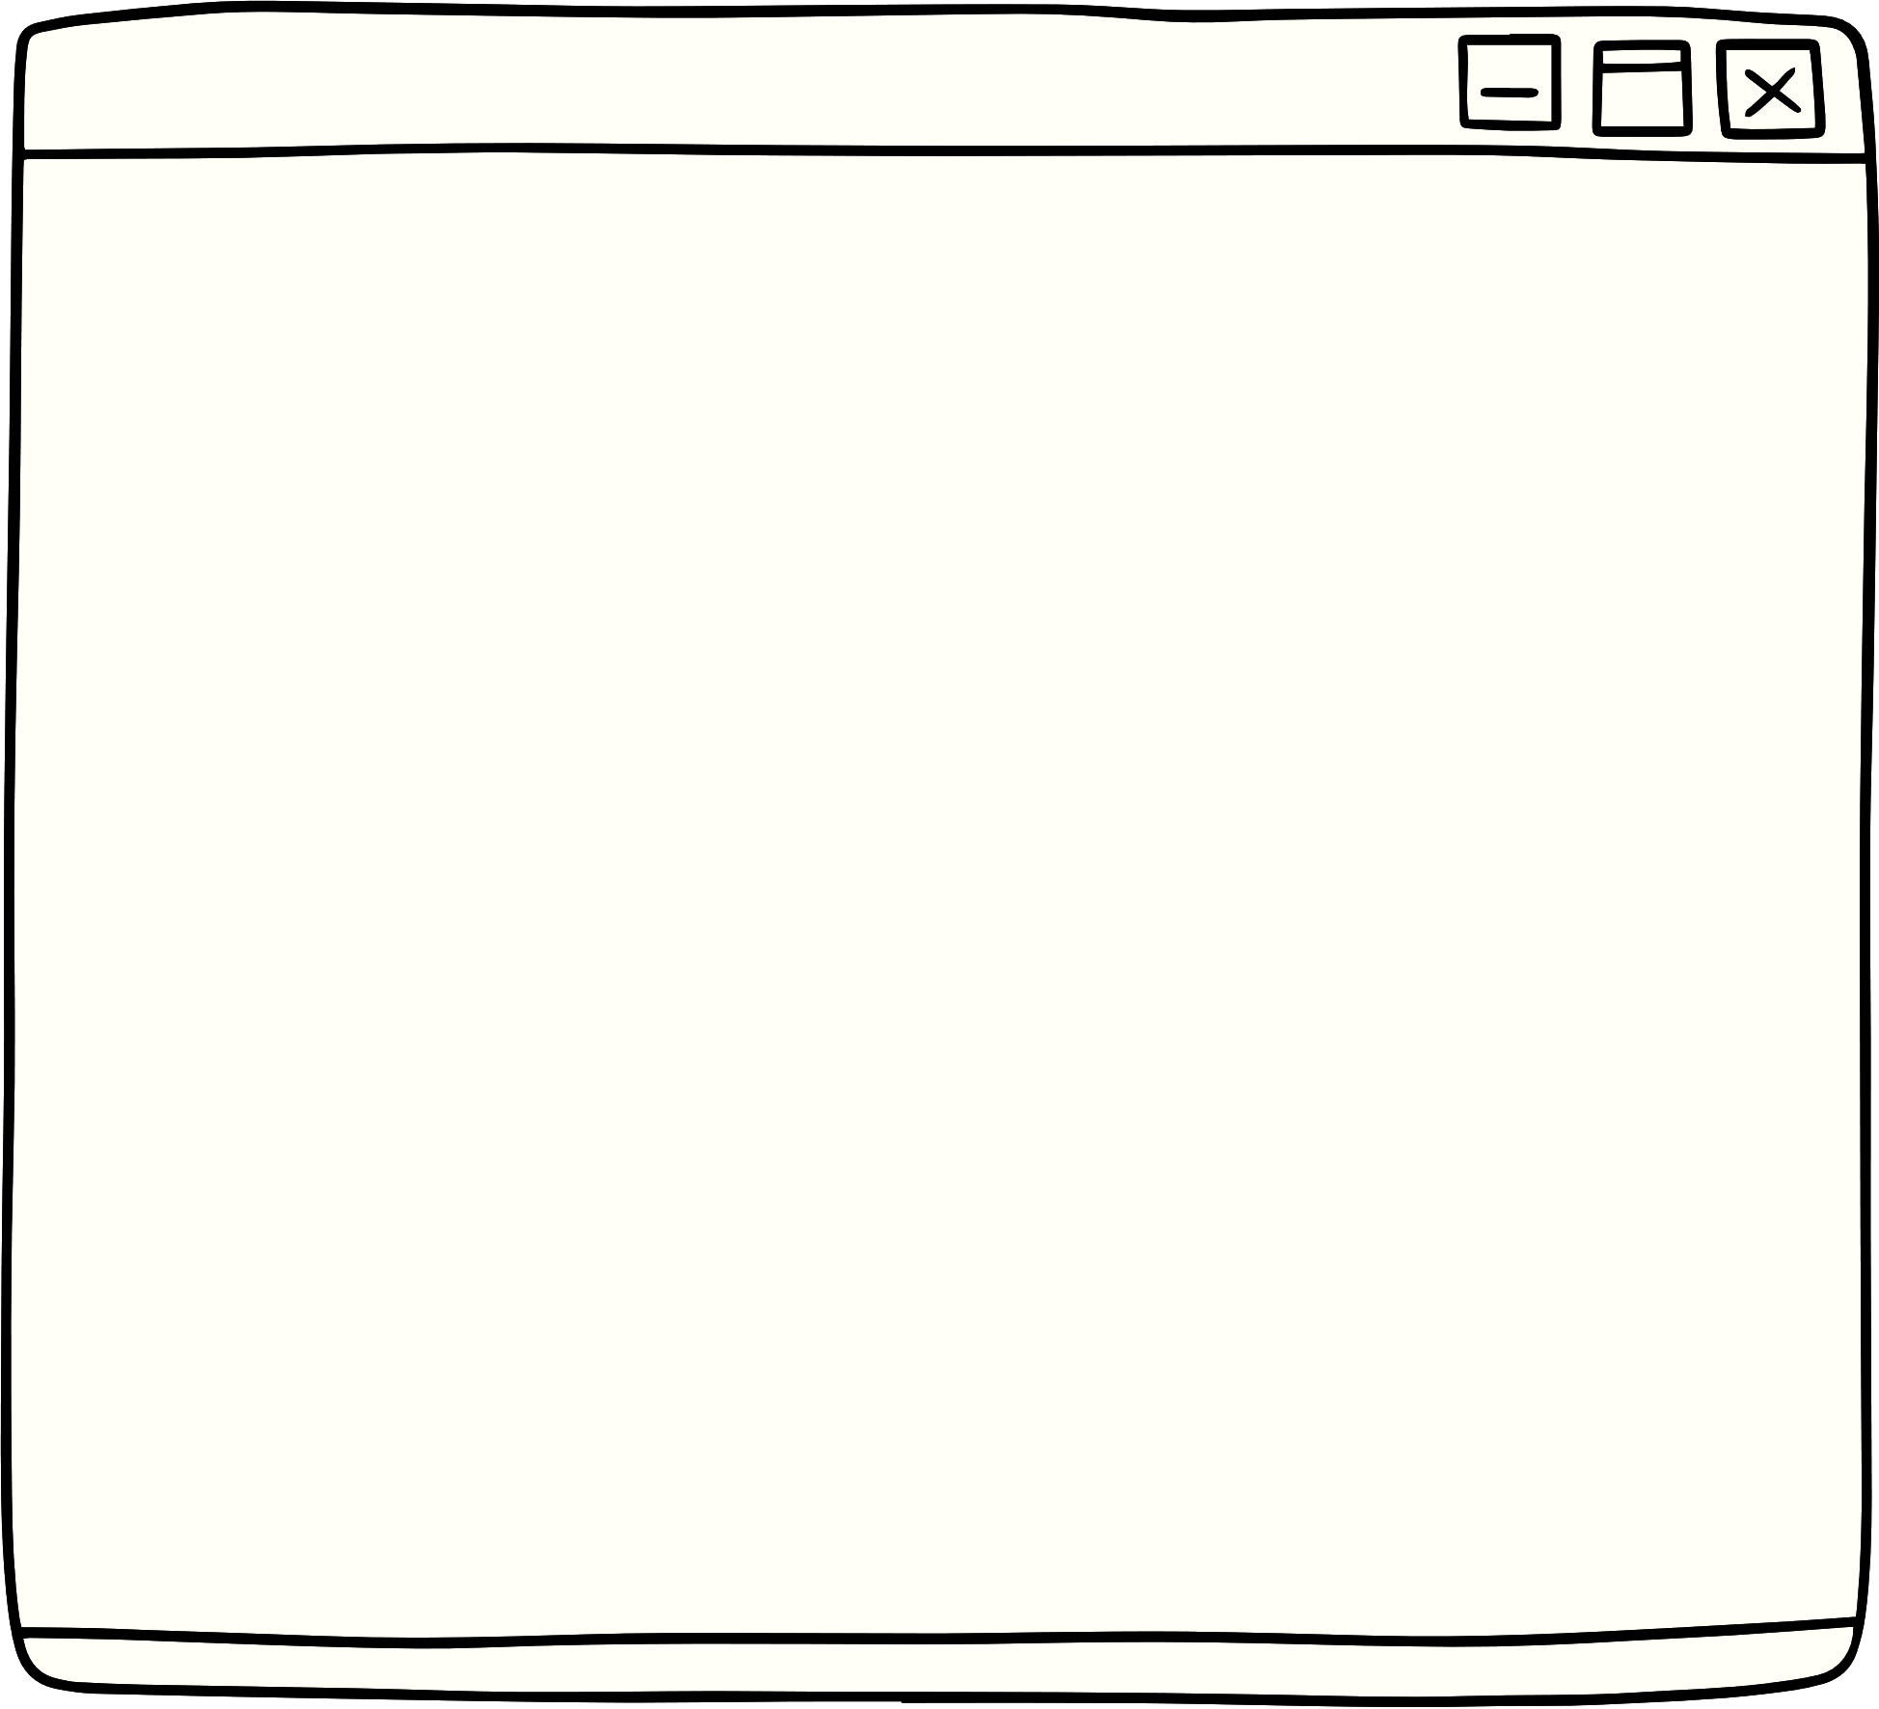



Challenges Faced
As this is AI based, it uses previous data to
provide a better response on the next data. It was tricky to figure out how we can store the previous data but the solution was simple enough i.e. just create a dict history.
The part which took a huge chunk of our time
is question generating part. First we had plans to have mcq questions and buttons to select an option. But it generated a lot of errors and took 3 hours of time so we scraped that idea and settled on this.

Slide 7



Future Scope
The future scope of AVT is vast. With the wind of modern world shifting towards the AI/ML path AVT might just be the next big thing. It can have a lot of things added like generative images to explain imaginary stories which will increase the imagination scope of youth and gain their interest quickly.

Slide 8








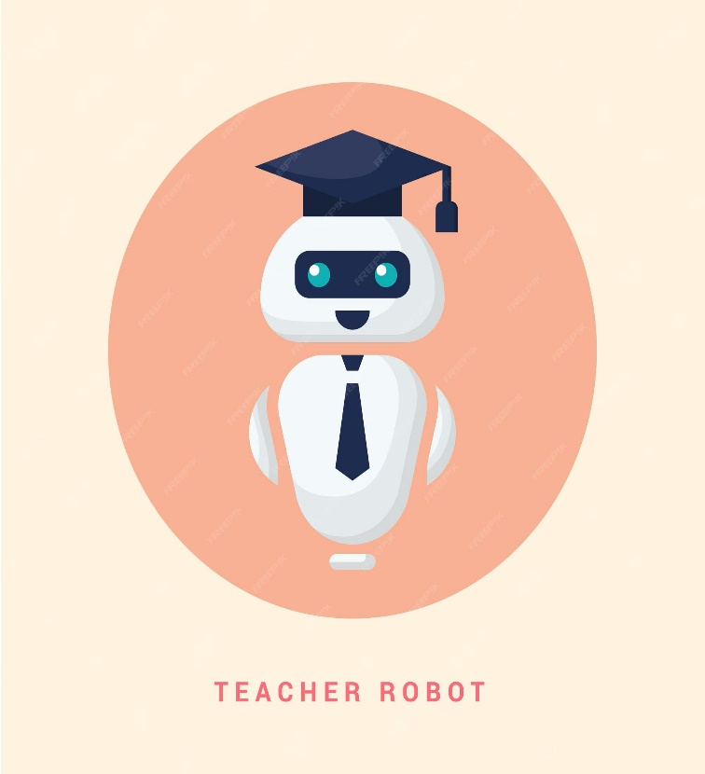







Technologies used
-Tkinter
-Pygame
Openai
speech_recognition
GTTS
Threading
11:11PM

Slide 9




Conclusion
The Personal AI Virtual Teacher represents the future of education, leveraging AI to empower students with personalized learning experiences, real-time feedback, and support. By harnessing the power of technology, we can revolutionize the way students learn, ensuring that every learner has the opportunity to reach their full potential.

Slide 10


Thank you
TEAM
Pritam Acharya
( 6370486583 )
Smrutiprava Das
( 9040858930 )

